Slide 1
BTC Software Programs – Update
Presented
By
FRA
[PSC]
01/21/2025

Slide 2
Agenda
BTC Software Projects Overview
Primary Test Structure & Process
Primary Consolidated Report Overview
Next Steps

Slide 3
BTC Software Projects Overview

Slide 4
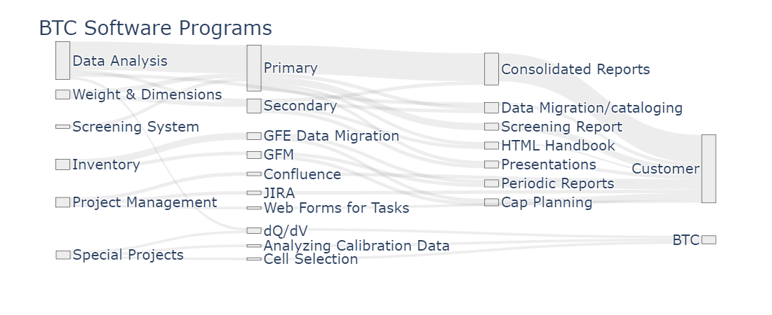
BTC Software Projects Overview
Notes:
Thickness of the line is relative to the amount of effort we are currently putting in each project

Slide 5
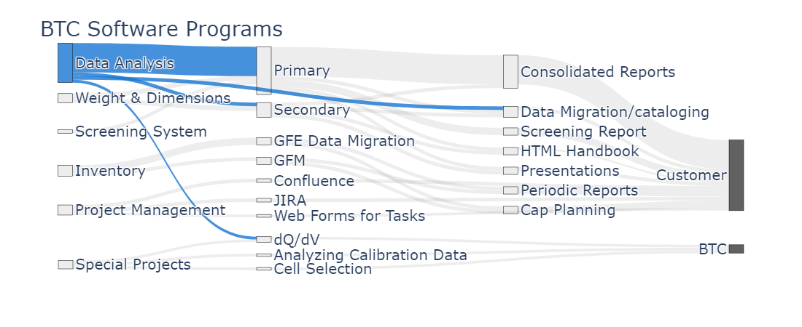
BTC Software Projects Overview
Notes:
Here are all the projects that we are working at the BTC
Thickness of the line is relative to the amount of effort we are currently spending in each project

Slide 6
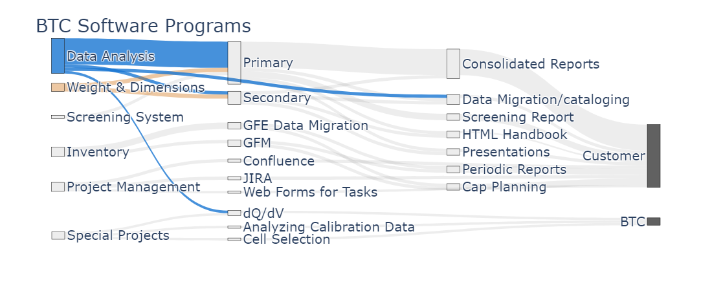
BTC Software Projects Overview
Notes:
Here are all the projects that we are working at the BTC
Thickness of the line is relative to the amount of effort we are currently spending in each project

Slide 7

BTC Software Projects Overview
Notes:
Thickness of the line is relative to the amount of effort we are currently spending in each project

Slide 8
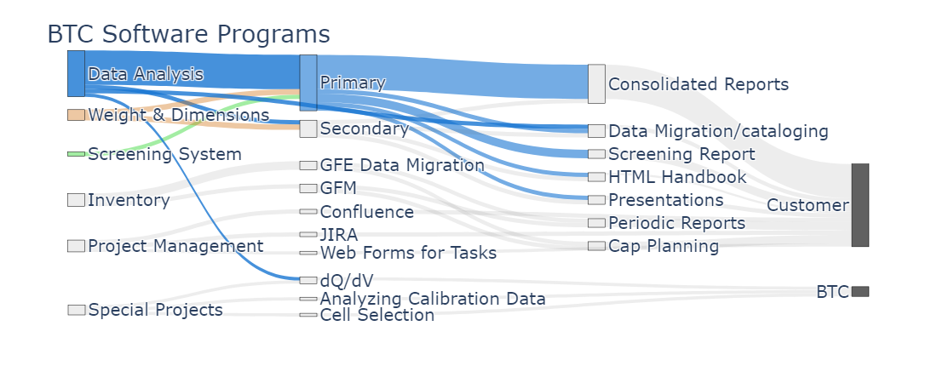
BTC Software Projects Overview
Notes:
Thickness of the line is relative to the amount of effort we are currently spending in each project

Slide 9
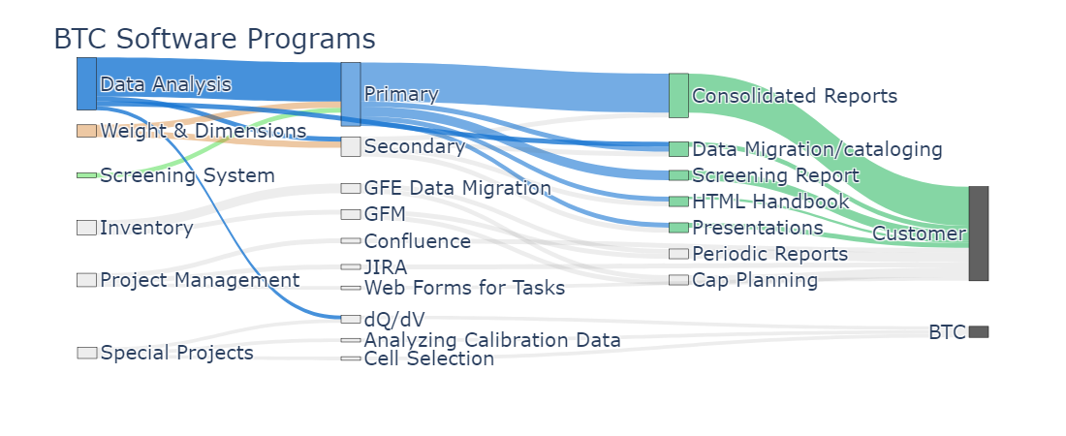
BTC Software Projects Overview
Notes:
Thickness of the line is relative to the amount of effort we are currently spending in each project

Slide 10
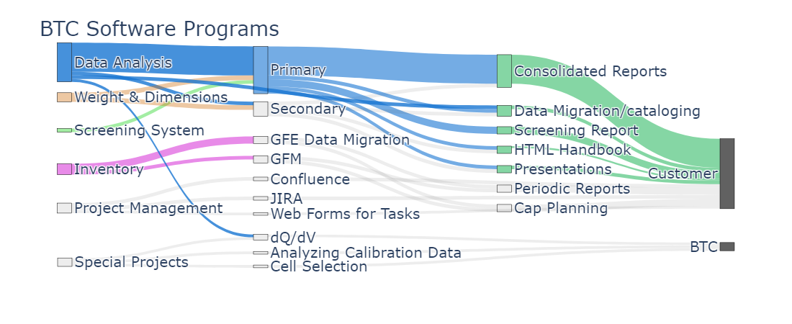
BTC Software Projects Overview
Notes:
Thickness of the line is relative to the amount of effort we are currently spending in each project

Slide 11
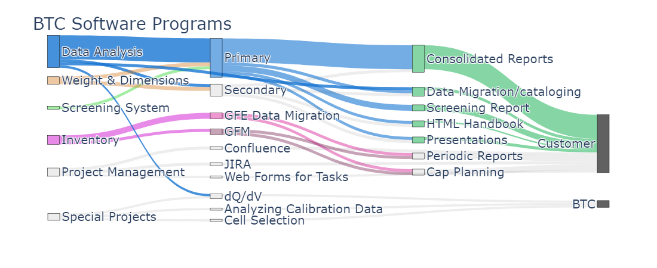
BTC Software Projects Overview
Notes:
Thickness of the line is relative to the amount of effort we are currently spending in each project

Slide 12
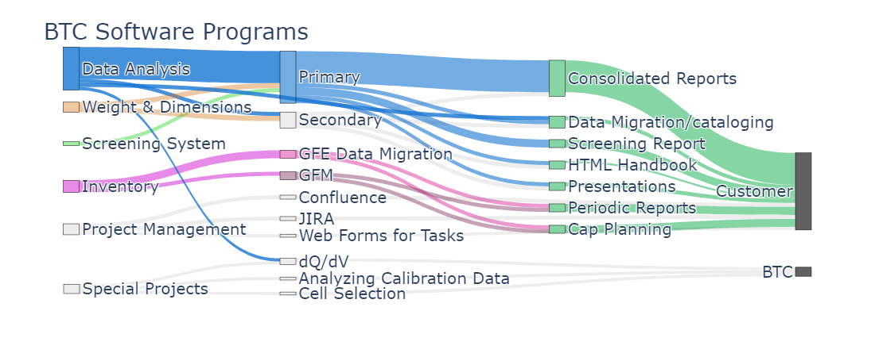
BTC Software Projects Overview
Notes:
Thickness of the line is relative to the amount of effort we are currently spending in each project

Slide 13
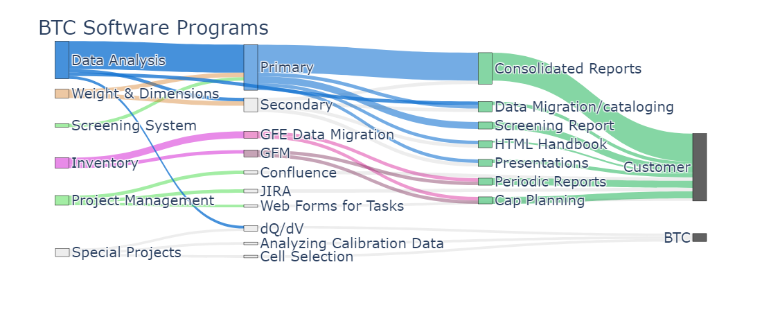
BTC Software Projects Overview
Notes:
Thickness of the line is relative to the amount of effort we are currently spending in each project

Slide 14
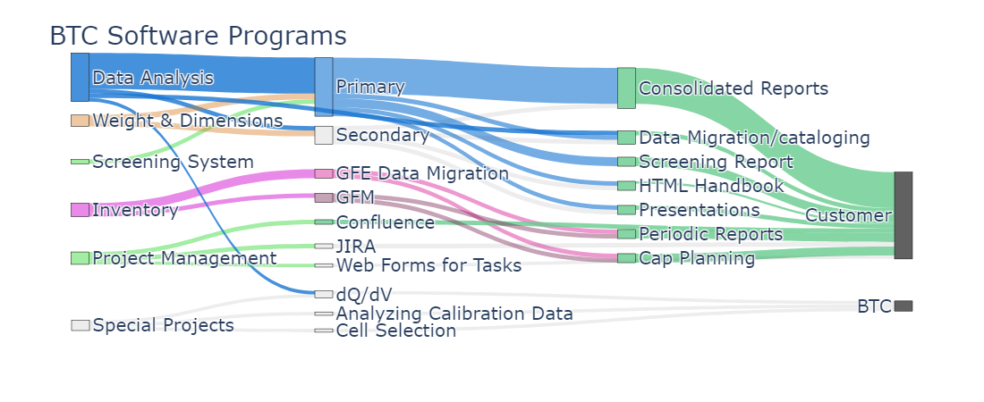
BTC Software Projects Overview
Notes:
Thickness of the line is relative to the amount of effort we are currently spending in each project

Slide 15

BTC Software Projects Overview
Notes:
Thickness of the line is relative to the amount of effort we are currently spending in each project

Slide 16

BTC Software Projects Overview
Notes:
Thickness of the line is relative to the amount of effort we are currently spending in each project

Slide 17
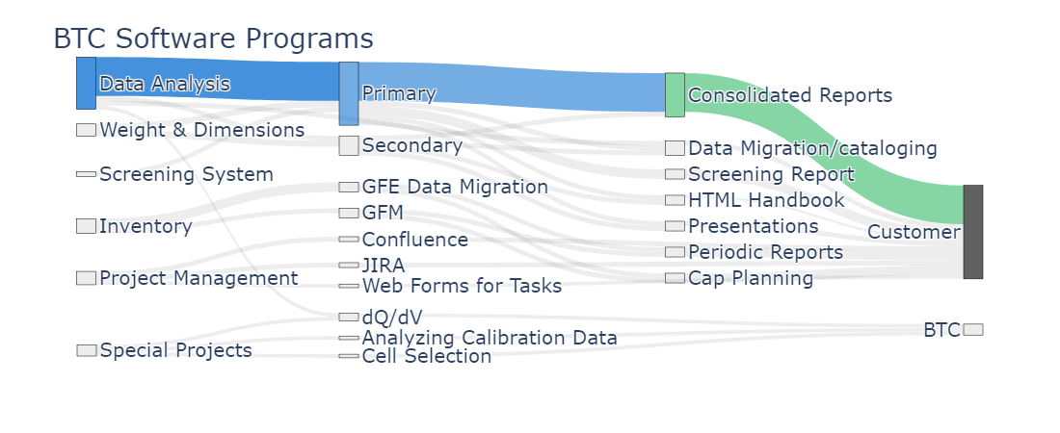
BTC Software Projects Overview
Notes:
Thickness of the line is relative to the amount of effort we are currently spending in each project

Slide 18
Primary Test Structure & Process

Slide 19

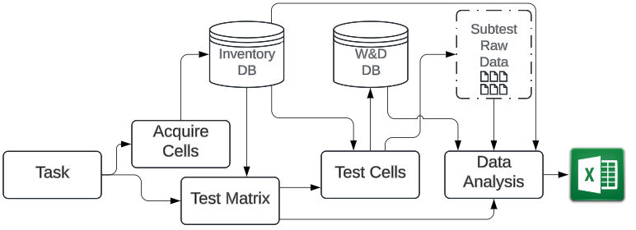
Primary Subtest Process
Notes:
Task Received
Gather all requirements for the test
Acquire Cells
Purchase cells if they are not already available
Enter Cell Information
Input detailed cell data into the inventory database

Slide 20
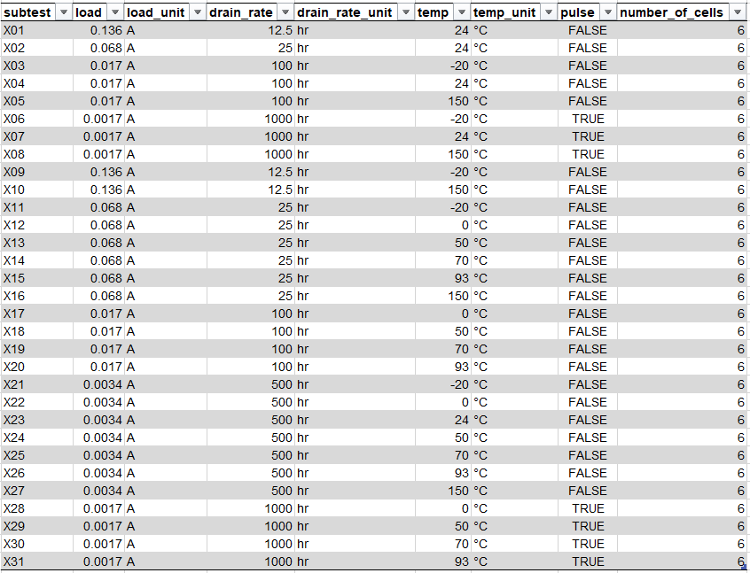
Primary Test Matrix

Slide 21
Primary Subtest Process
Notes:
Task Received
Gather all requirements for the test
Acquire Cells
Purchase cells if they are not already available
Enter Cell Information
Input detailed cell data into the inventory database

Slide 22
Subtest Data Analysis
Data Analysis
Software analyzes every cell in the subtest.
Report test metrics at each voltage cutoff.
Create tables.
Generate data visualizations.
Weight and dimensions for each cell are queried from the W&D SQL Database.
Test Engineer Review
Handles test discrepancies.
Validates data.
Performs further data analysis if needed.
Notes:
The reason why I will explain in detail the primary data analysis process is to convey that although most of the process is automated, the process is still very involved for test engineers. This show that the data is validated and reviewed before building the report.

Slide 23
Primary Subtest Process
Notes:
Task Received
Gather all requirements for the test
Acquire Cells
Purchase cells if they are not already available
Enter Cell Information
Input detailed cell data into the inventory database

Slide 24
Subtest Excel File
Enables Python to efficiently extract tables.
Facilitates data validation, analysis, and error correction by test engineers.
Median cell is selected based on median capacity at principal voltage cutoff.
Subtest Excel file serves as data storage, with Python processing the data.
This file is reviewed by two additional test engineers.

Slide 25
Primary Subtest Process
Notes:
Task Received
Gather all requirements for the test
Acquire Cells
Purchase cells if they are not already available
Enter Cell Information
Input detailed cell data into the inventory database

Slide 26
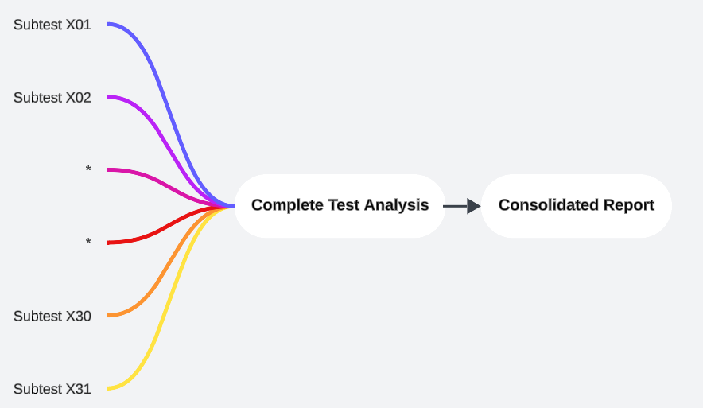

Subtests to Consolidated Reports
Complete Test Analysis
Consolidated Report
Notes:
Process of extracting tables and median cells is automated, reducing formatting and copy/paste operations for test engineers. Plo

Slide 27
Primary Consolidated Report Overview

Slide 28
Consolidated Report
Summary of the complete Test.
Includes all tables from each subtest.
Most data visualizations include only the median cell from each subtest.

Slide 29
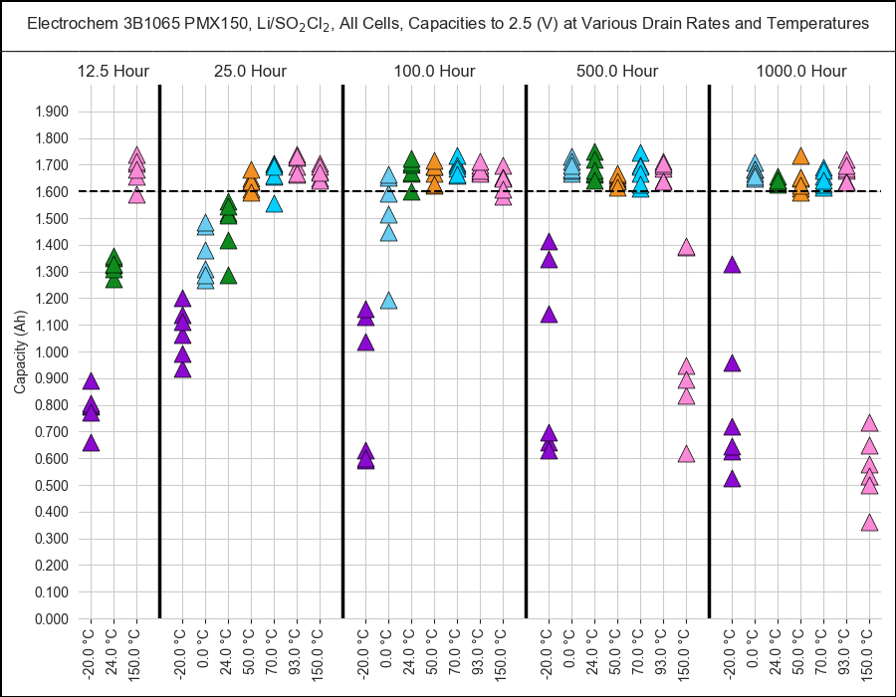
Data visualization – All Cells Capacity

Slide 30
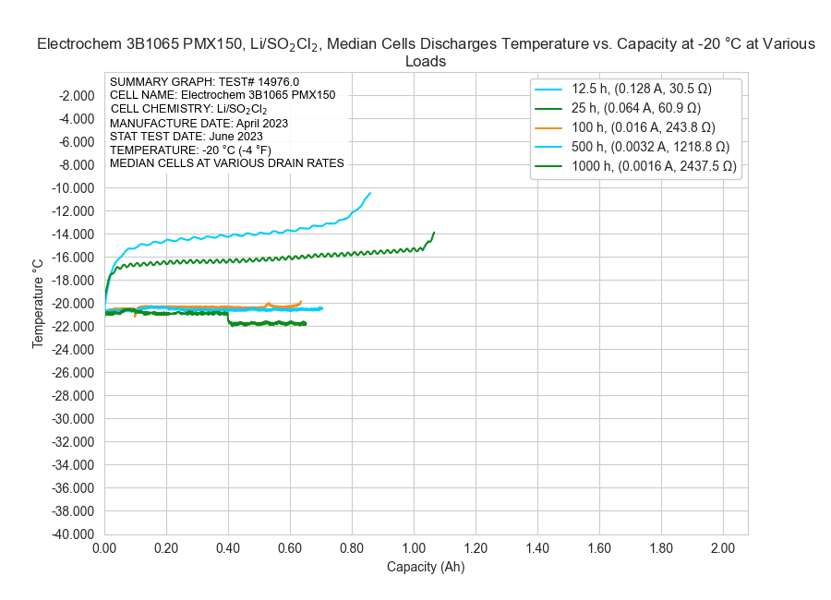
Data visualization – TvC

Slide 31
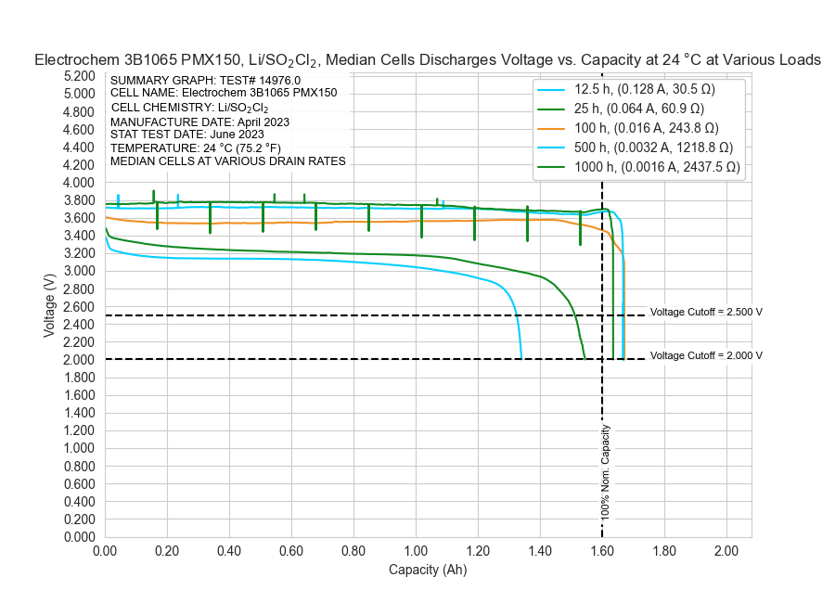
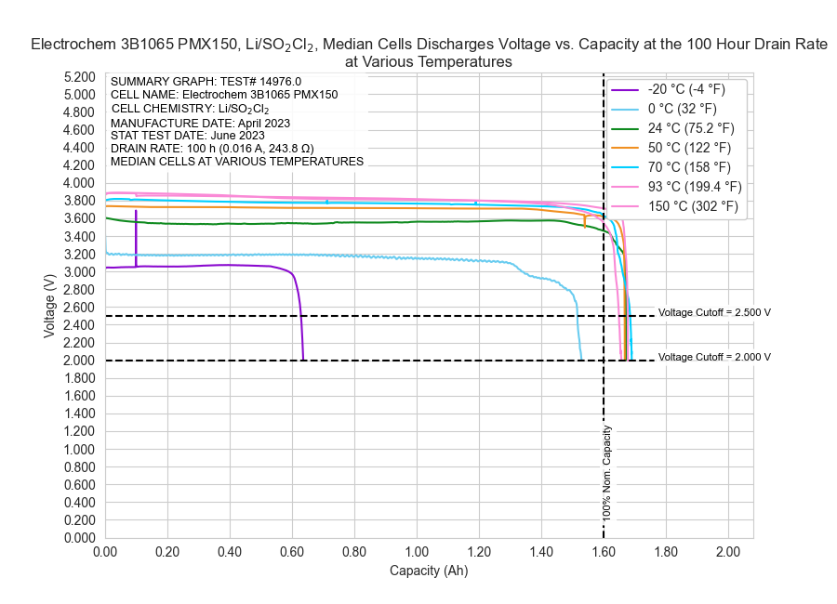
Data visualization – VvC
All drain rates at a specific temperature
All temperatures at a specific drain rate

Slide 32
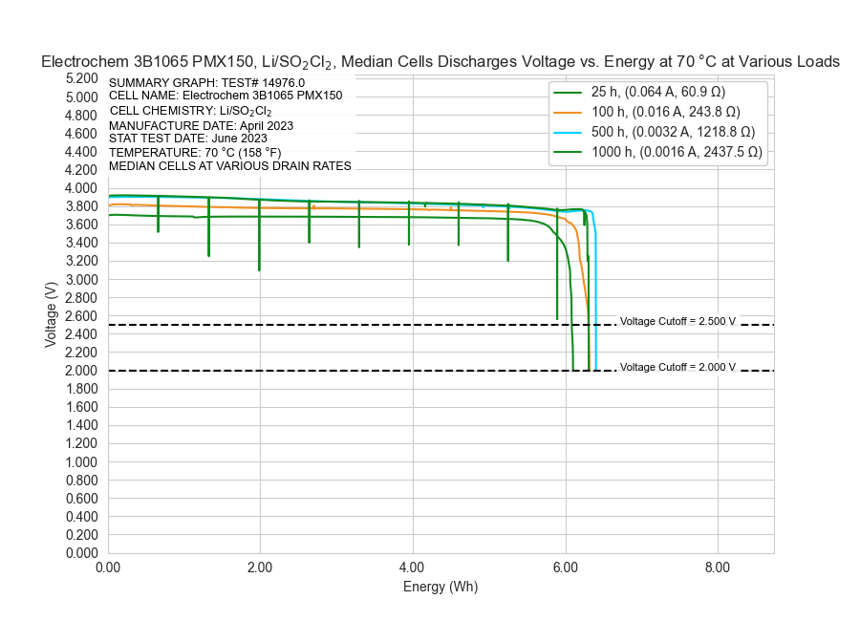
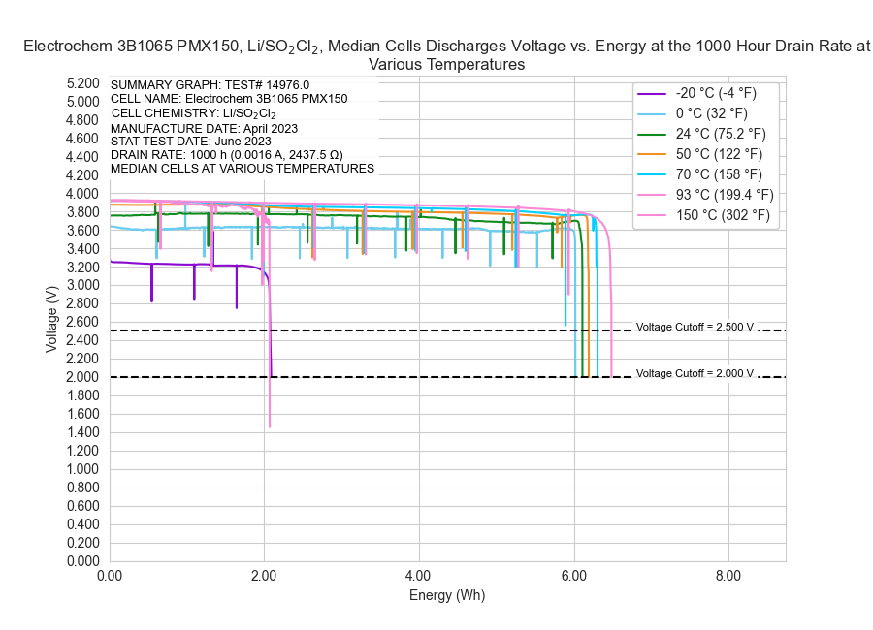
Data visualization – VvE
All drain rates at a specific temperature
All temperatures at a specific drain rate

Slide 33
Tables
Tests metrics
Test voltages
Weight and dimensions
Voltage drops
Total Pulse (TP) voltage drop is now included
DCIR
Total DCIR (DCIR TP) is now included

Slide 34
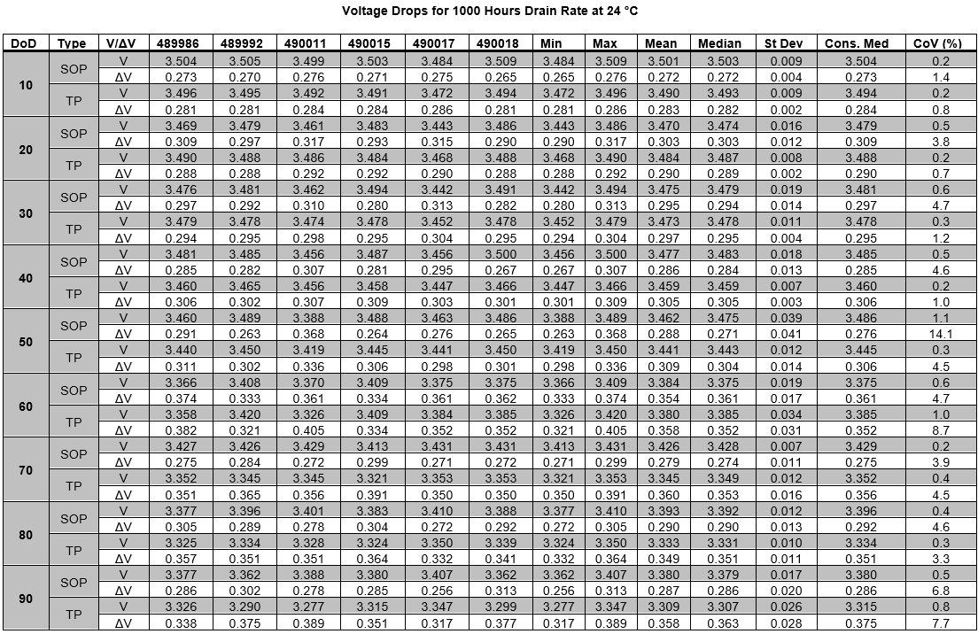
Voltage Drops

Slide 35
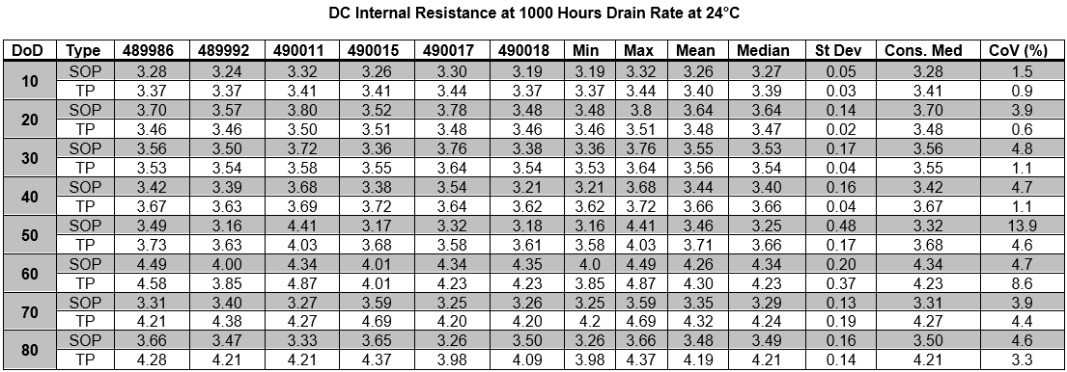
DCIR Table

Slide 36
Consolidated Report Notes
The majority of the process is now automated using Python.
Test engineers are still involved to ensure data accuracy and to conduct further data analysis.
The process for creating a consolidated report is aligned with building presentation and primary handbook entries.

Slide 37
Next Steps

Slide 38
Next Steps
Deliver primary consolidated reports
Enhance primary data analysis software
Transition to secondary consolidated reports

